Slide 1

2. Django urls, views and templates (Creating the project and running the server)
Md. Nahiyan Uddin
Lecturer
Department of CSE
University of Asia Pacific

Slide 2
Objectives
MVC Pattern
Django project structure
MVC pattern in django
Creating new urls
Creating views for the urls
Creating templates for the views
Django template tags

Slide 3
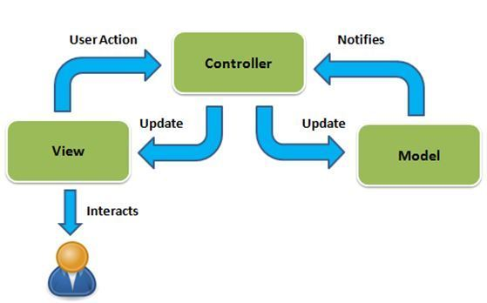
MVC Pattern
M – Model
V – View
C – Controller

Slide 4
Django Project Structure

Slide 5


Slide 6
django mvc
urls.py
models.py
views.py

Slide 7
Create Sub-systems (apps)
django-admin startapp demo
python manage.py startapp demo2

Slide 8
Front-End (client) – Back-End (server)
Frond-End
Back-End
Full-Stack
Front-End -> Request -> Back-End
Back-End -> Response -> Front-End

Slide 9
Next Topic: Templates
Httprespond()
render()

Slide 10
Adding the ‘template’ folder
In our django project, we will show the pages of our project through rendering html files from views.py file functions
These html files will be stored in the template folder of each app
Create a template folder in your app folders and store your html files there

Slide 11
Built-in template tags and filters
https://docs.djangoproject.com/en/4.1/ref/templates/builtins/

Slide 12
$ python manage.py makemigrations
$ python manage.py migrate
$ python manage.py createsuperuser

